Slide 1

How Not to Throw Your Reserve

Slide 2
Your reserve is not your 2nd chance, it’s your last chance

Slide 3
Decide to throw
Look at the handle
Throw horizontal, into clear air, away from your body, opposite to the glider
Let go of the handle
Disable the main canopy

Slide 4
Skyhigh Swing & Fling

Slide 5

DEPLOYMENT PROCEDURE
If you need to throw your reserve then do so with conviction:
Look – Reach – Pull - Throw
Look at the handle, grab it and rip it off the Velcro end extend your arm to pull out the deployment bag,
throw the bag and handle away from you into clear space, not towards your wing,
as hard as you can and LET GO of the handle.
Aim to throw with the direction of airflow to aid a fast opening and against the direction of rotation.
The most important thing after the reserve is deployed and it is open,
is to remember to completely disable the wing so that it does not act against the parachute
and cause a down-plane.
Whichever method you choose do so symmetrically, you do not want the paraglider to start rotating,
this could cause the paraglider to fly into and effectively disable the parachute.

Slide 6

Rescue Deployment In the event of an emergency, you must quickly evaluate your height
and the seriousness of the incident.
A seconds hesitation in deploying the reserve could prove fatal if there is insufficient height.
If you decide to deploy the rescue:
Look for the rescue handle and grasp it firmly with one hand
Pull forwards and upwards on the handle to release the deployment bag from the rescue container.
In a continuous motion, throw (and RELEASE!) the rescue away from yourself and the glider, preferably into the air stream or against the direction of spin.
After deployment, avoid entanglement and pendulum motions by promptly pulling in the glider

Slide 7
Flybubble
Good throw
Nick Neynens holds handle

Slide 8
Paraglidingforum discussion on direction
Many conflicting opinions about up, down, sideways.
Most seem to say down, as in relative to you, which is opposite to the glider
Throwing it down
Every situation is different:
Stable cravatted, plenty of time to look, throw out behind,
Fast spiral … stable, predictable but horizontal

Slide 9
“Having done it twice now (in non-SiV situations ) I can safely offer advice of aiming for just above the horizon behind you. It needs to be out, it needs to be hard.
If you threw it at your mate on the ground then you'd take him off his feet.
If you're rotating hard you'll still have an idea of where above the horizon is. ”

Slide 10
Don’t be frightened by loud noise
Hold brakes in one hand
Look at handle
Will you need 2 hands?
Try to orient yourself … direction of spiral … which way is up
Throw out, towards trailing edge
Let go of the handle
Kill the glider canopy

Slide 11
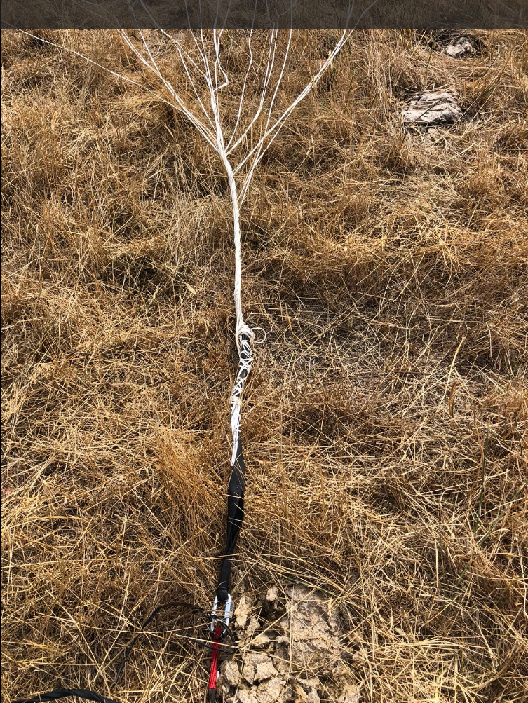

Slide 12
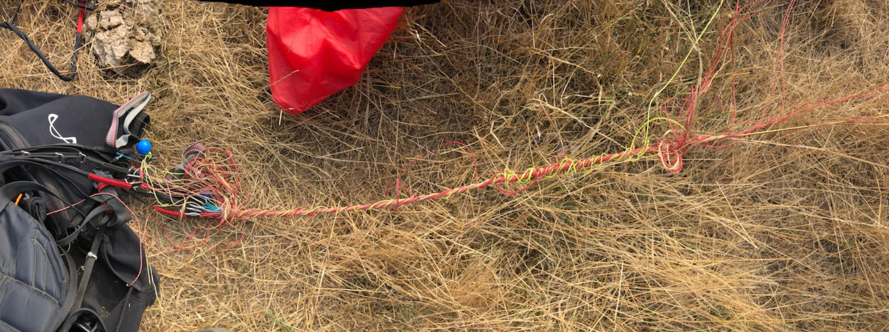

Slide 13
Do some reading, talking, watching
Practice in your head

